Slide 1

CAMPUS LOST & FOUND PORTAL
Name : Kancharla Saran Kasyap
Reg.No : 43110388

Slide 2
ABSTRACT
The project is a Campus Lost & Found Portal developed using Java full-stack technology.
The backend is built using Spring Boot, and MySQL for data storage.
It helps students and staff report, search, and claim lost or found items within the campus.
The frontend is designed using HTML, CSS, JavaScript for dynamic content rendering.
Users can register, log in, post lost/found items, upload images, and communicate securely.
A search and filter mechanism allows users to find items easily based on category, date, or location.
The project enhances campus efficiency and trust by reducing lost item.

Slide 3
EXISTING SYSTEM
In most campuses, lost and found processes are handled manually, using notice boards or physical registers.
No centralized database exists to record or track lost and found items efficiently.
Delay in communication between the finder and the owner results.
Records, if maintained, are paper-based, which are prone to loss, damage, or duplication.
Searching for a particular item among manual entries is time-consuming.
The existing approach lacks notifications or tracking features, causing inconvenience to users.
Overall, the manual system is inefficient, unorganized, and not scalable for large campus populations.

Slide 4
PROPOSED SYSTEM
The Campus Lost and Found Portal provides a centralized digital platform to manage all lost and found activities within the campus.
Users can register, log in, and securely report lost or found items through the web application.
The system uses a database (MySQL) to store all item details, user information, and communication logs.
The backend (Spring Boot) ensures smooth data handling, validation, and processing.
The frontend (JavaScript + CSS) offers an interactive and user-friendly interface.
Users can upload images and descriptions to help identify items accurately.
A search and filter feature allows users to quickly find matching lost or found items.
The system helps save time, improve efficiency, and ensure transparency in the item recovery process.

Slide 5
ADVANTAGES
Provides a centralized online platform for managing lost and found items within the campus.
Saves time and effort by eliminating manual record and physical visits.
Ensures quick search and retrieval of lost items using advanced filters and categories.
Offers secure user authentication to prevent unauthorized access.
Enhances communication between finder and owner through an integrated system.
Maintains accurate and permanent digital records, minimizing data loss.
User-friendly interface improves accessibility for students, faculty, and staff.
Scalable and flexible architecture allows easy future expansion or feature integration.

Slide 6
DISADVANTAGES
Requires a stable internet connection for access and operation; not usable when offline.​
Potential for false or inaccurate item reports or claims by users if not properly verified.​
Needs regular admin monitoring to prevent misuse or fraud and to resolve claim disputes.​
Security concerns may arise if personal data or contact information is not adequately protected.​
Users unfamiliar with web technology or first-time users may face usability challenges and need guidance.

Slide 7
HARDWARE REQUIREMENTS
Processor: Intel Core i3 or higher (recommended i5/i7 for better performance).
RAM: Minimum 4 GB (8 GB recommended for smooth operation).
Hard Disk: At least 250 GB storage capacity for database and project files.
Monitor: Standard 15” or larger display for clear interface visibility.
Keyboard and Mouse: For user input and navigation.
UPS (Uninterrupted Power Supply): To prevent data loss during power interruptions.
Internet Connection: To ensure stable access for users and administrators.

Slide 8
SOFTWARE REQUIREMENTS
Operating System: Windows 10 / 11, Linux (Ubuntu), or macOS.
Programming Language: Java (JDK 17 or above recommended).
Backend Framework: Spring Boot (for REST API and business logic).
Frontend Technologies: HTML, CSS, JavaScript for dynamic web pages).
Database: MySQL (for data storage and retrieval).
Server: Apache Tomcat (embedded in Spring Boot).
IDE (Integrated Development Environment): VS Code.
Build Tool: Maven(for dependency management).
Version Control: Git / GitHub (for code management and collaboration).
Web Browser: Google Chrome / Mozilla Firefox / Microsoft Edge (for testing and access).
Postman / Swagger: For API testing and documentation.

Slide 9
MODULES
User Module:
Handles user registration, login, and profile management.
Lost & Found Module:
Allows users to post details of lost or found items with images and descriptions.
Search & Match Module:
Enables users to search items and automatically suggests possible matches.
Admin Module:
Admin reviews posts, manages users, and maintains system data.
Security & Database Module:
Ensures data protection, authentication, and efficient database operations.

Slide 10
MODULE DESCRIPTION
User Module: This module manages all user-related operations, including registration, login, updates. It ensures user has secure and personalized access to post, search, items.
Lost & Found Module: Handles the submission of lost and found item reports with details. Supports photo uploads to make identification and verification of items easier.
Search & Match Module: Enables users to browse and locate items quickly using keyword or filter-based search. The system automatically matches similar entries between lost and found posts to speed up recovery.
Admin Module: Provides the administrator with tools to monitor system activity, verify posts, and handle user management. Maintains data accuracy and content moderation to prevent false or duplicate entries.
Security & Database Module: Responsible for data handling, encryption, and secure storage of user and item records in MySQL. Incorporates authentication and access control mechanisms to protect sensitive information.

Slide 11
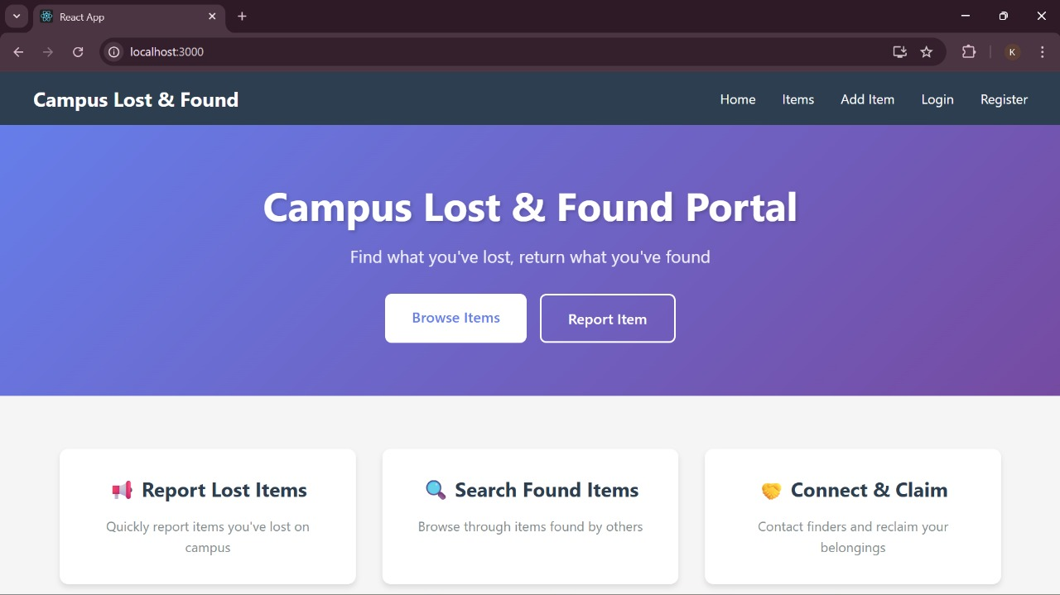
SAMPLE OUTPUT

Slide 12
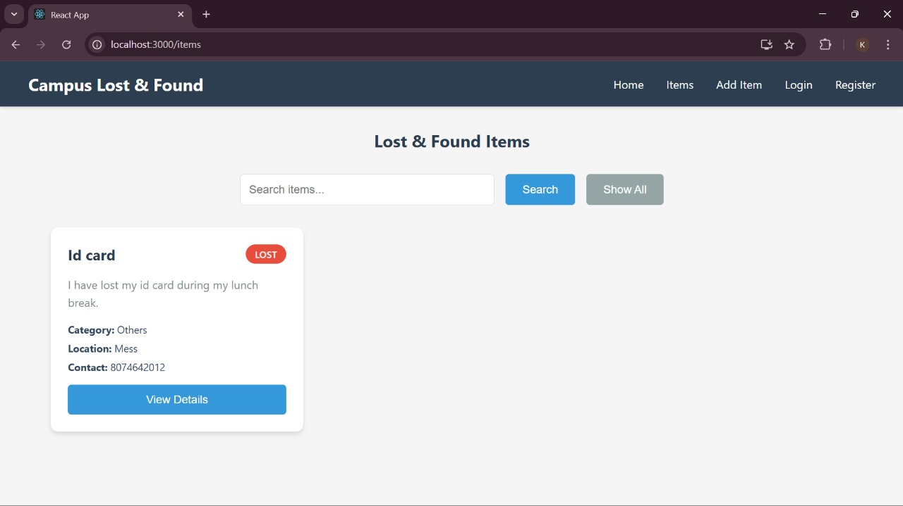
SAMPLE OUTPUT

Slide 13
CONCLUSION
The Campus Lost and Found Portal successfully provides a digital solution to manage lost and found items within the campus.
It replaces the manual, time-consuming process with an efficient and automated web-based system.
The portal enhances communication between users and improves the chances of item recovery.
Admin verification and secure login ensure reliability and prevent misuse.
The use of Java full-stack technologies (Spring Boot, MySQL, Thymeleaf) makes the system robust and scalable.
Search filters add convenience and speed to the item retrieval process. The project promotes digitalization, transparency, and user trust within the campus environment.
In the future, features like mobile app integration, QR-based tracking, and AI-based image matching can further enhance system efficiency.

